Slide 1
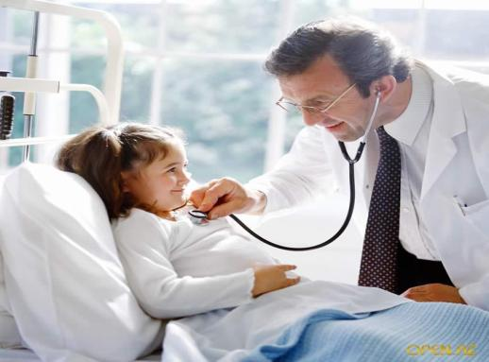
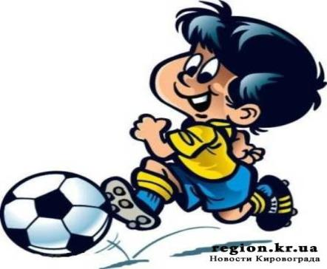

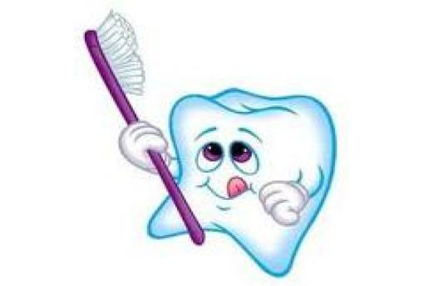

Slide 2

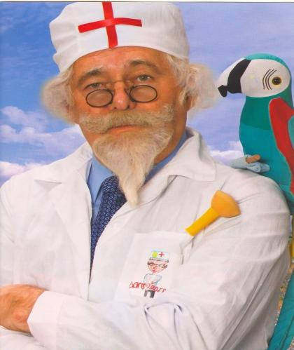

HEALTH

Slide 3
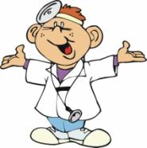
THE PROVERBS
  1. Health is
above wealth.
4. Early to bed and
early to rise makes a man healthy, wealthy and wise.
6. An apple a day
keeps the doctor away.

Slide 4
Unscramble the words
Ekep nutemi
asye spat
heltahy cesond
gurelar terquar
chawt
hlaf

Slide 5
Check yourself
Keep past
Easy second
Healthy quarter
Regular
Watch
Half
Minute

Slide 6
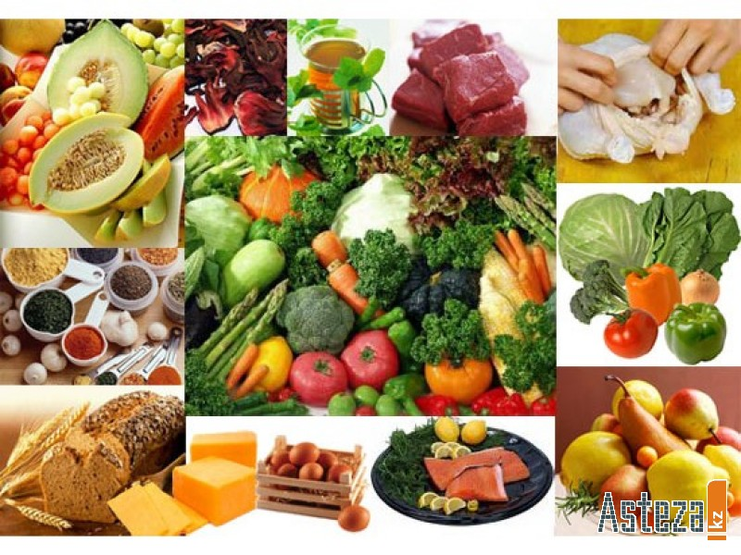

Slide 7
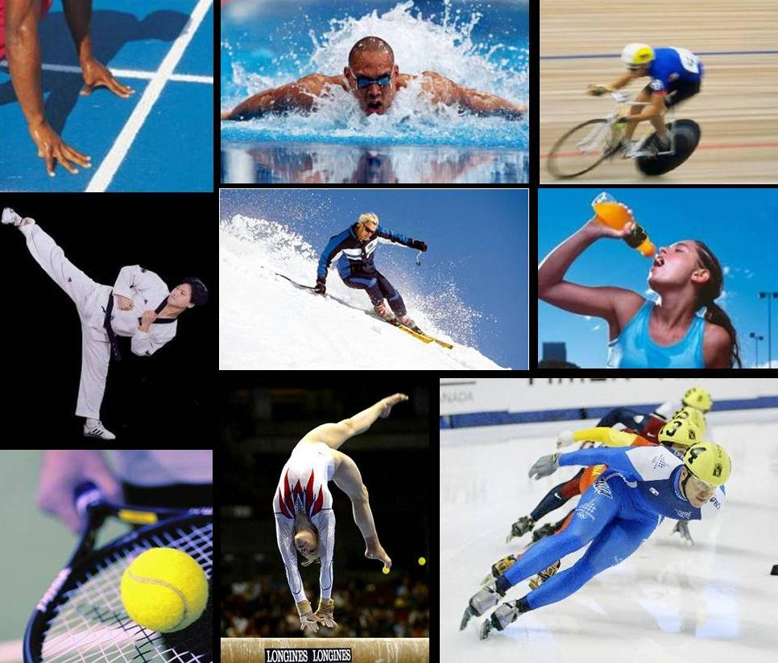

Slide 8
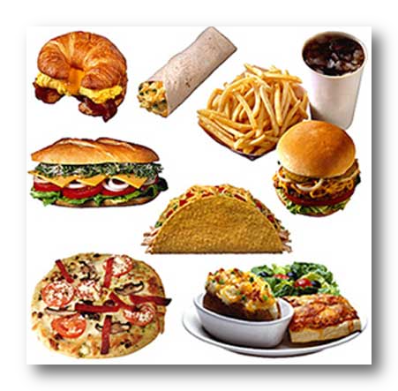

Slide 9
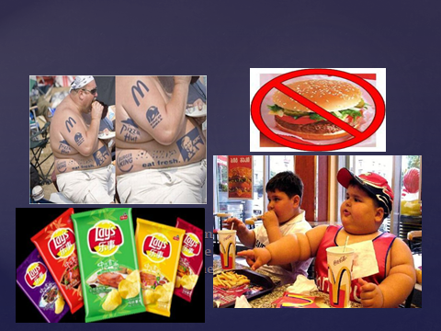

Slide 10
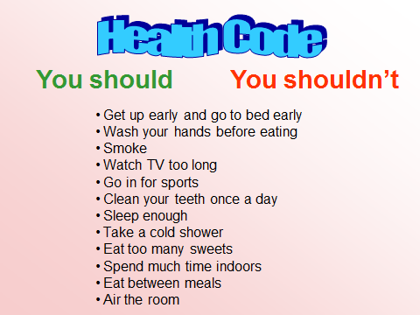

Slide 11
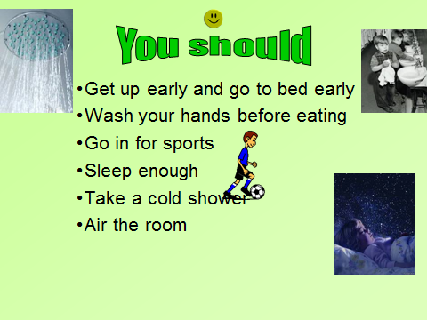

Slide 12
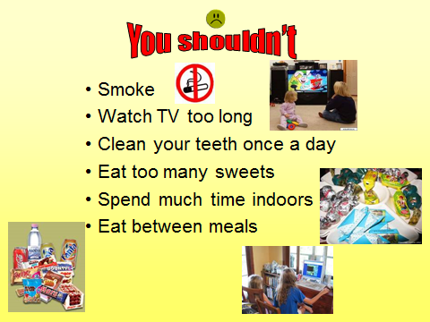

Slide 13

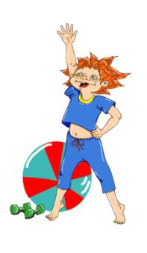
QUESTIONS:
  1. Is it easy for you to get up early in the morning?
  2. Do you do your morning exercises every day?
  3. What sport do you go in for?
  4. Do you eat healthy food?
  5. Do you clean your teeth before
  meal or after it?
6. Do you eat sweets?

Slide 14
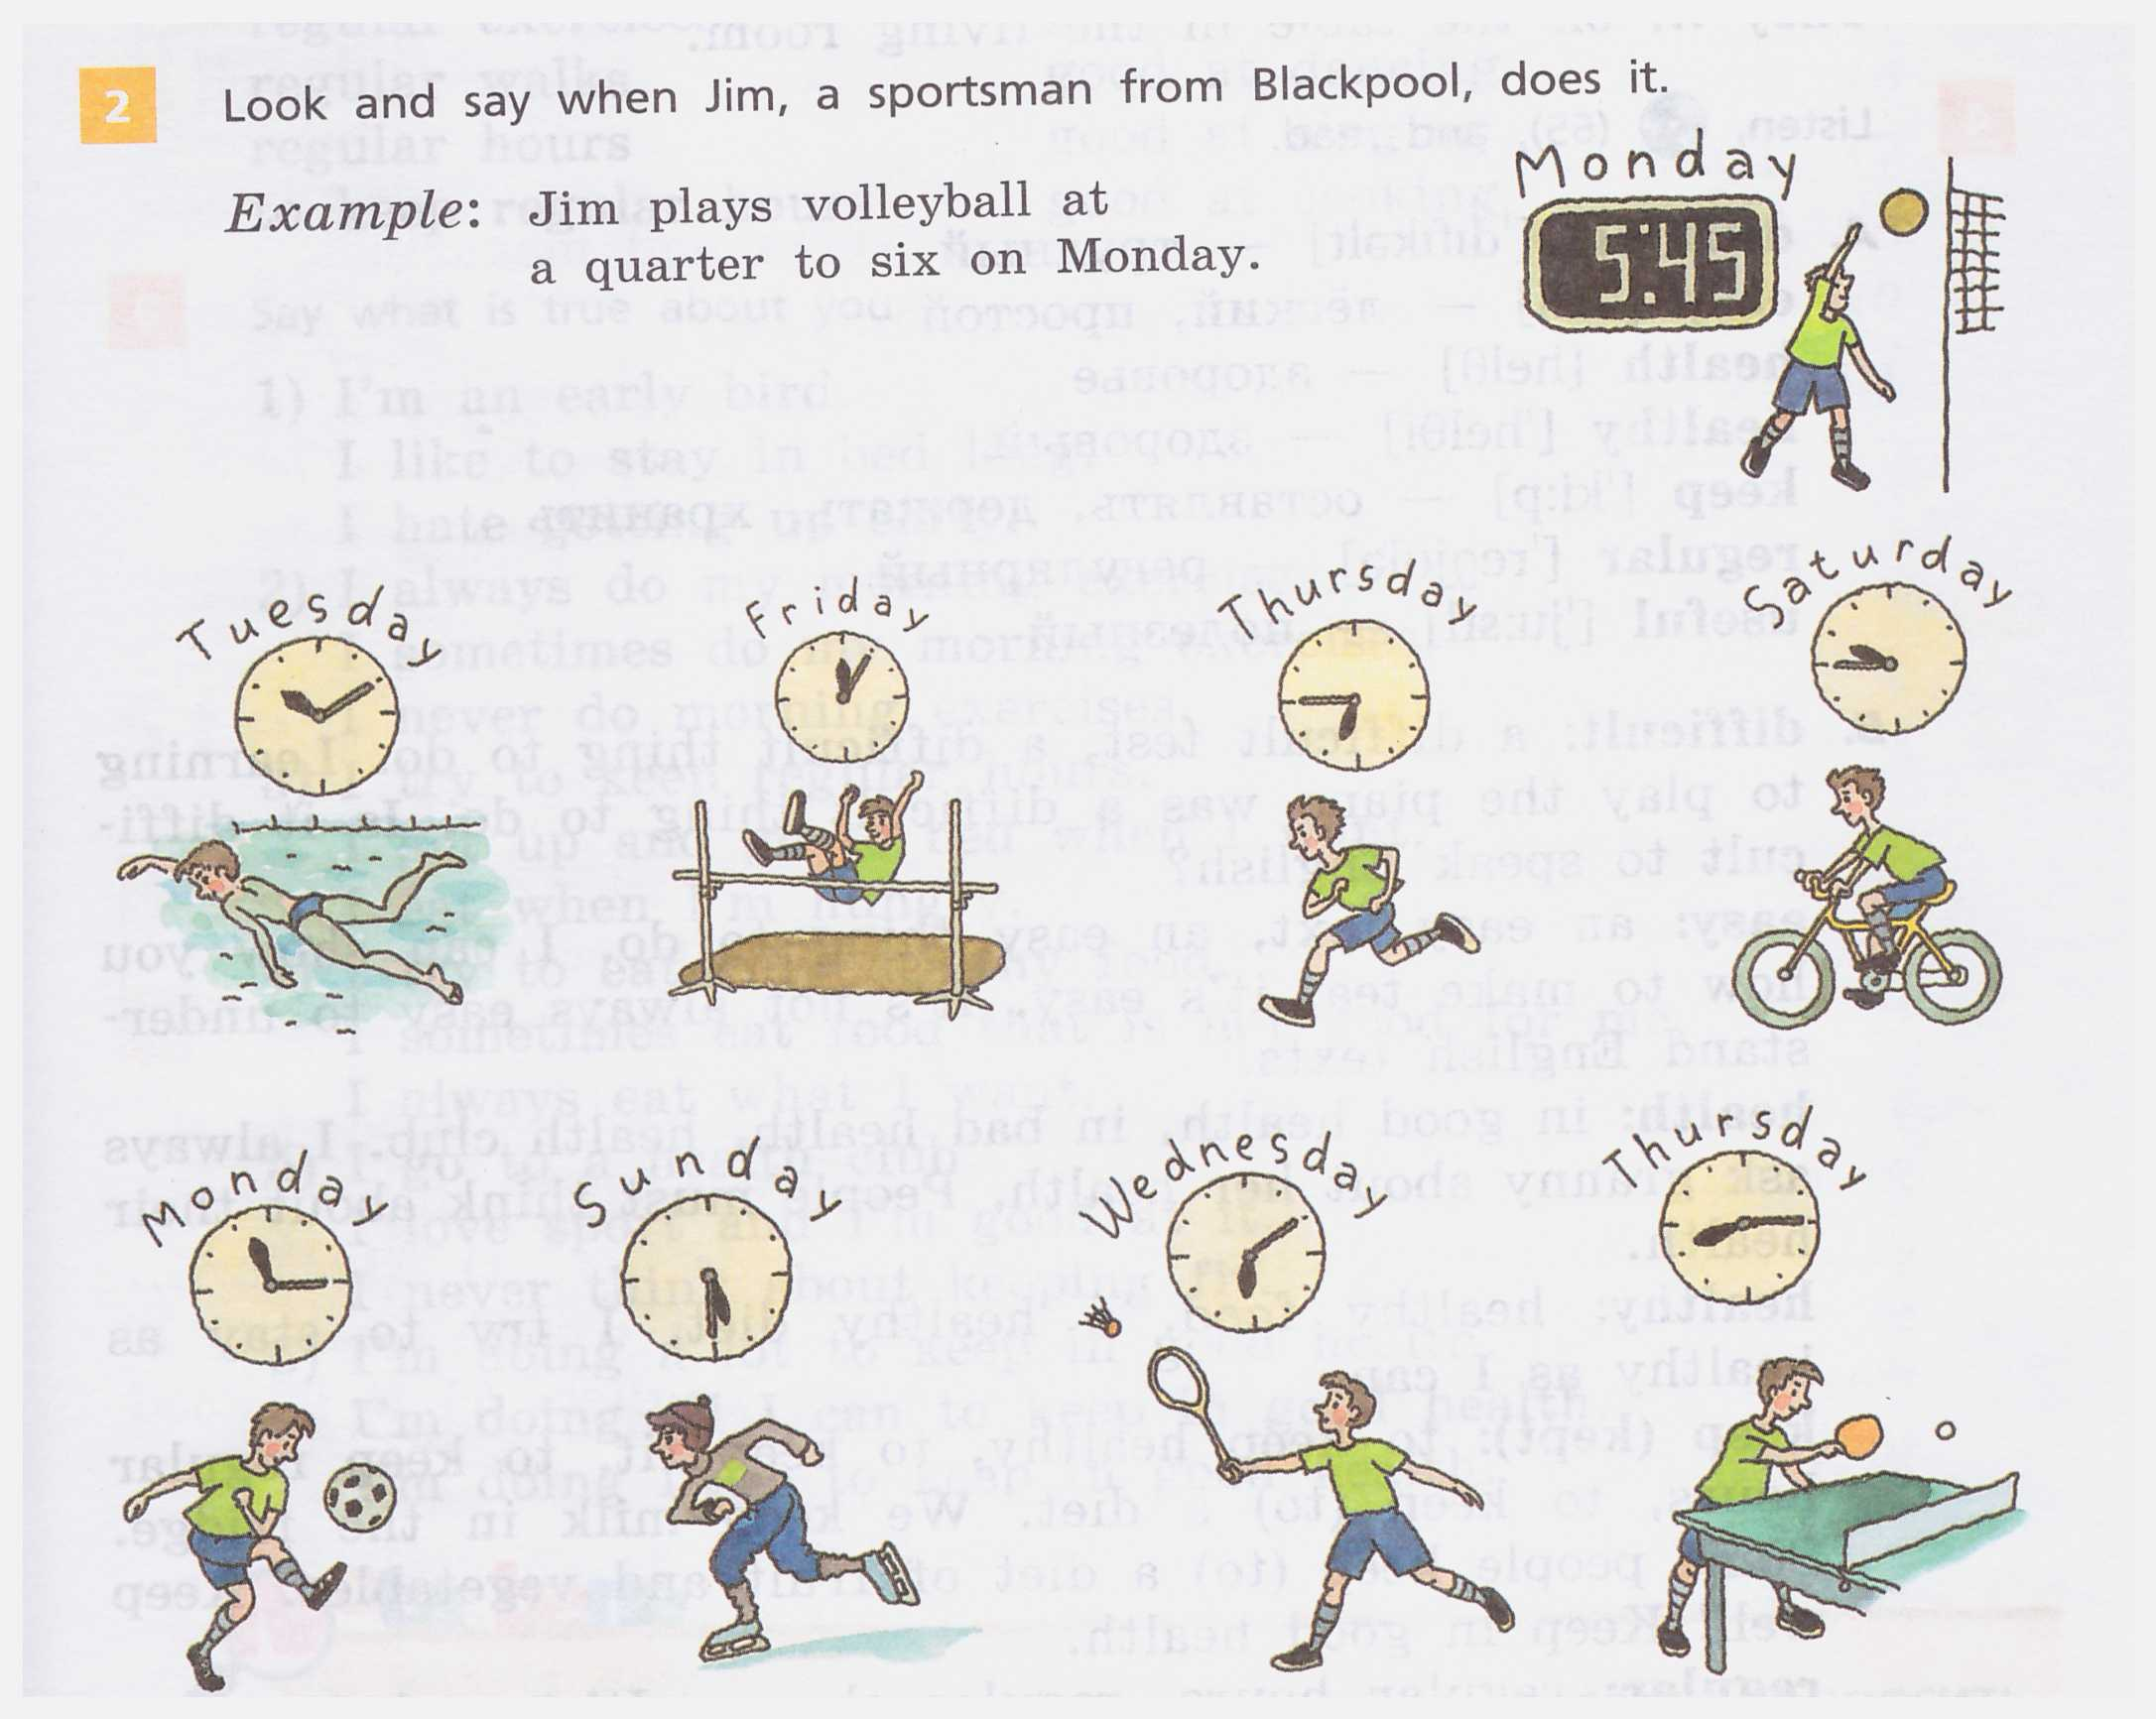
Look and say when Jim does it.

Slide 15
Listening
9:45 6:50
3:15 6:30
11:30 7:25
7:58
12:05
8:45

Slide 16

Let’s have a rest and do exercises

Slide 17


Slide 18
Match the words.
To go in teeth
to get for sport
to clean up
to wash exercises
to do morning hands
to keep food
healthy fit

Slide 19
Key
To go in for sport
to get up
to clean teeth
to wash hands
to do morning exercises
to keep fit
healthy food

Slide 20
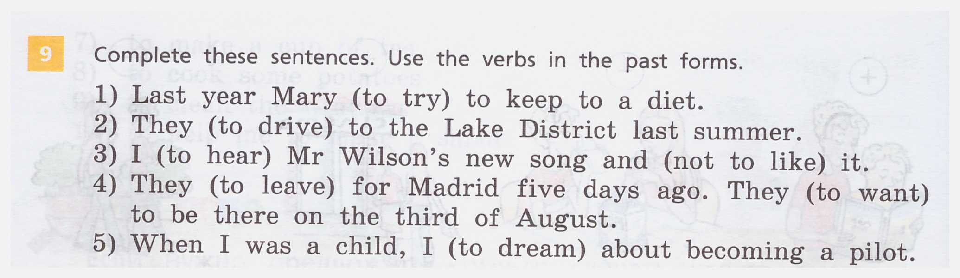
Use the verbs in the past forms.

Slide 21
Key
Tried
Drove
Heard, did not like
Left, wanted
Dreamed, (dreamt).

Slide 22
FINAL TEST
Fill in the missing words
a).get up, b).hands, c).healthy, d).exercises, e).teeth, f).shower, g).fit, h).little, i).much, j).sweets, k).bad, l).smoke, m).go to bed, n).junk, o).skip.
1. ……..early and ……..early to keep fit. 2.Take regular ………… to keep fit. 3. Take a cool/cold ……….. to keep fit. 4. Eat …………. food to keep fit. 5. Never ……. to keep ……. . 6. Clean your …….. every morning and every evening. 7. Wash your ……… before meals. 8.Too ……food makes you thin. 9. Too ……. food makes you fat. 10. ……… food makes you ill. 11. Too many ………. are ….. for your teeth. 12. Never ……… breakfast

Slide 23

KEY
1. a, m. 7. b.
2. d. 8. h.
3. f. 9. i.
4. c. 10. n.
5. l, g. 11. j, k.
6. e. 12. o.

Slide 24

ASSESSMENT OF THE TEST
“5” – NO MISTAKES
“4” – 1 or 2 MISTAKES
“3” – 3 or 5 MISTAKES
“2” – MORE THAN 5 MISTAKES

Slide 25
HOMETASK
Ex. 4 p. 116 – Complete the sentences. Use the words from the box.
Ex. 3 p. 119 – Read the text and answer Yura’s question.

Slide 26

BE HEALTHY!!!

